Slide 1
Electronic publishing
Abdul latif (1)
Farid aziz wicaksono (14)
Muhammad zaafril s. (25)

Slide 2
criteria of a good desktop/ electronic publishing
General Criteria:
Present and potential relevance to community needs
Suitability of physical form for library use
Suitability of subject and style for intended audience
Importance as a document of the times
Attention by critics and reviewers
Potential user appeal
Requests by library patrons

Slide 3
Content Criteria:
Authority
Comprehensiveness and depth of treatment
Skill, competence, and purpose of the author
Reputation and significance of the author
Objectivity
Consideration of the work as a whole
Clarity
Currency
Technical quality
Representation of diverse points of view
Representation of important movements, genres, or trends
Vitality and originality
Artistic presentation and/or experimentation
Sustained interest
Relevance and use of the information
Effective characterization
Authenticity of history or social setting

Slide 4
Top Five Recommended Public Library Reviewing Sources:
Booklist
Goodreads
New York Times Book Review
Publishers Weekly
Shelf Awareness
Source : http://www.ala.org/tools/challengesupport/selectionpolicytoolkit/criteria

Slide 5
Exercise 5
1. What features should an electronic book reader have?
Usability
You may go through several hours with your electronic book reader, and it is essential that you feel good utilizing it.
Resolution
While the device’s resolution doesn’t solely determine an e-reader’s screen quality, it’s a decent marker of how sharp onscreen text looks.
Pixels
This is the number of physical pixels on the display.High-density screens are useful for readers with glasses or sight problems, however, high and low-end displays with no less than 150 ppi are as yet usable for most of the readers.
Screen Size
All e-book readers let you change the font size of the text you’re reading, so even a smaller screen can display a significantly bigger size than you’re used to seeing in a book, magazine, or newspaper.

Slide 6
Adjustable Brightness
Ebook readers’ displays can be difficult to read in the dark.Devices with adjustable screen brightness, back-light the screen so you can read in different levels of light. This is a useful feature if you frequently read in the dark or at night.
Battery Life
The other big advantage of E-Ink readers is the battery life, which is measured in weeks, not hours.
Connectivity
All modern eBook readers are WiFi enabled, which means you can use them to connect to your home internet to download books. This can be done without a computer and usually, the process is straightforward. Choosing books from the library or from an online bookstore, shouldn’t make any difference if your device has options for both.
Library Support
Many local libraries will let you check out an eBook on loan – just as you can do with a regular book. Previously, support for this varied among e-readers and tablets. However, now it’s basically universal.

Slide 7
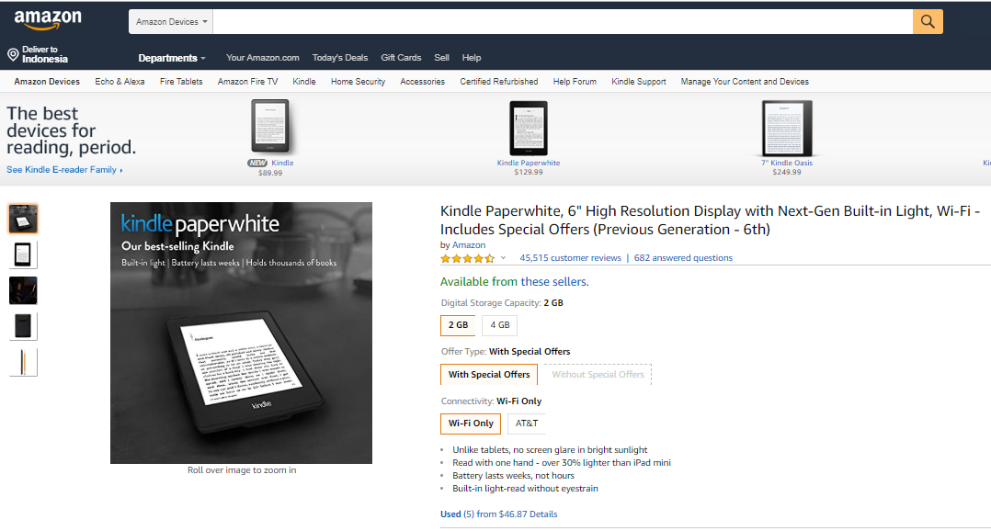
2. Compare two different electronic book readers in terms of its features.
Amazon
Headquarters: Seattle
Year Founded:1995
Founder: Jeffrey Bezos Jeffrey Bezos
Market cap: $18.3 billion
Number of employees: 7,600
Price-to-earnings ratio:Not meaningful
2002 revenue: $3.93 billion
2002 earnings per share: 39 cents
CEO:Jeffrey Bezos
CEO's favorite book: The Remains Of The Day by Kazuo Ishiguro Price of The Teeth of the Tiger, the No. 1 fiction book on the New York Times
Best-Seller List: $16.77, plus shipping
Best feature:Free shipping on orders over $25; personalized recommendations based on past purchases

Slide 8
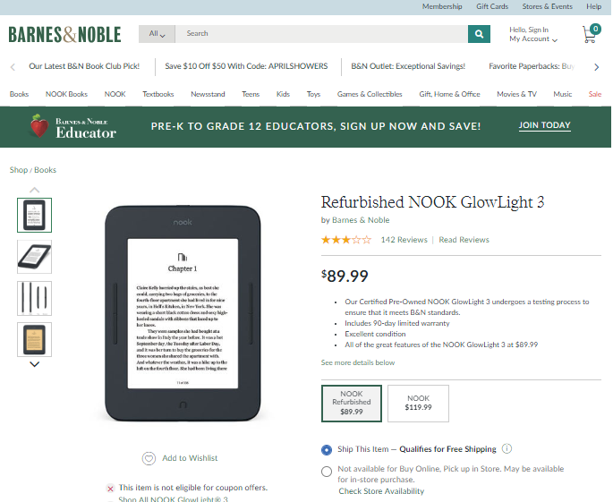
Barnes & Noble
Headquarters: New York
Year Founded: 1917
Founder: William Barnes/G. Clifford Noble
Market cap: $1.7 billion
Number of employees: 50,000
Price-to-earnings ratio: 14.97
2002 revenue: $5.27 billion
2002 earnings per share: $1.39 (diluted)
CEO: StephenRiggio Stephen Riggio
CEO's favorite book: The Metamorphosis by Franz KafkaPrice of The Teeth of the Tiger, the No. 1 fiction book on the New York Times
Best-Seller List: $19.57, plus tax
Best feature:No waiting for purchase to arrive in the mail; cafés

Slide 9

Which do you think is more interesting than the others?
Amazon and Barnes & Noble comparison, both are equally attractive but we are more interested in barnes and noble because of the more attractive design of barnes and noble. besides that barnes and noble has an anti-reflection layer and faster battery charging time.

Slide 10

3. Will we still need them printed in the future or it is enough to have their digitalized version?
in our opinion still, because too long seeing the screen is not good for eye health, even many people are more comfortable reading in books than reading on a smart phone

Slide 11
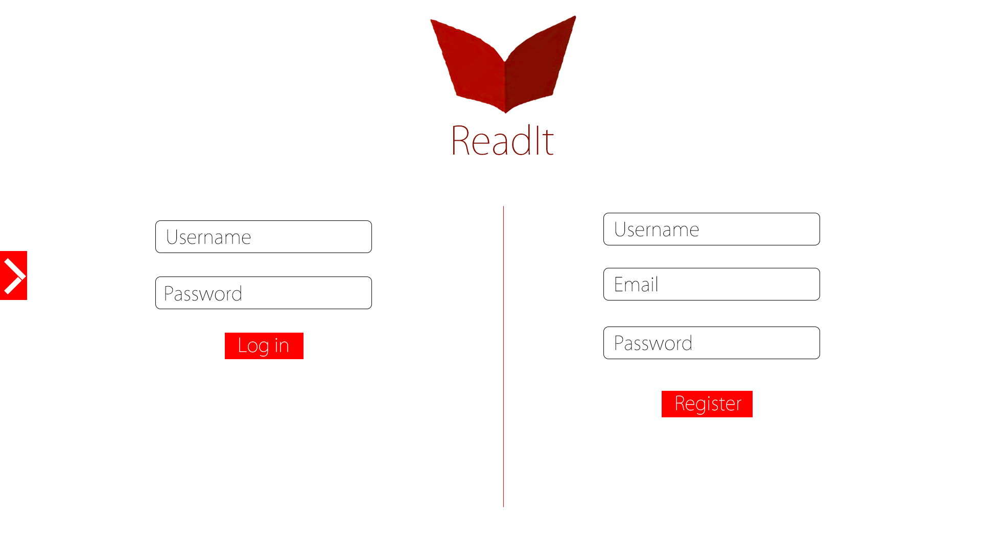
Login and register page
Before user can use the application, user must login by insert the username and password.
Or if user not registered, user must insert username, email and password to register account.

Slide 12
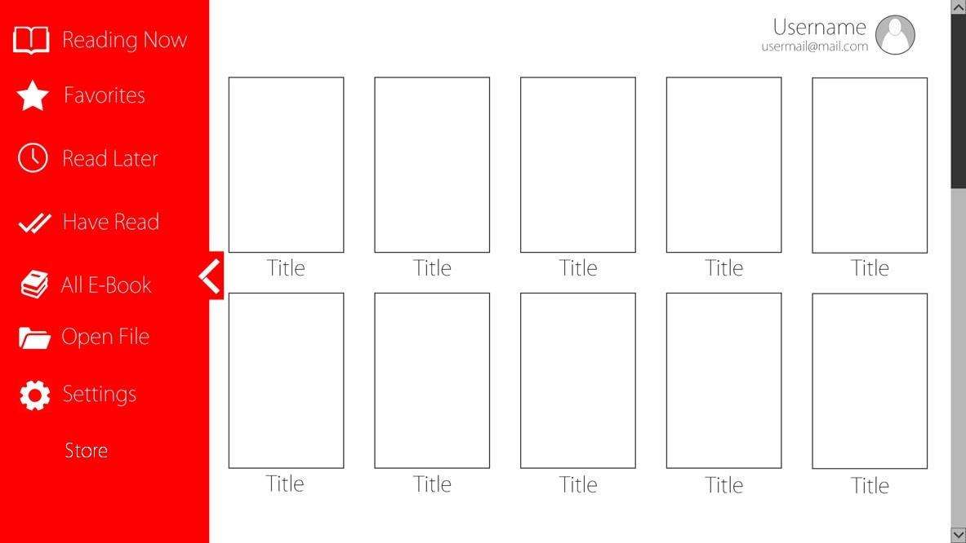

Home page
Reading now used to open ebook being read
Favorites used to see ebooks favorite
Read later used to see ebooks which will be read later
Have read used to see ebooks that have been read
All ebook used to see all ebooks
Open file used to open ebook file stored in storage
Settings used to set the ebook reader application
Store used to show ebooks which you want to buy
Search

Slide 13
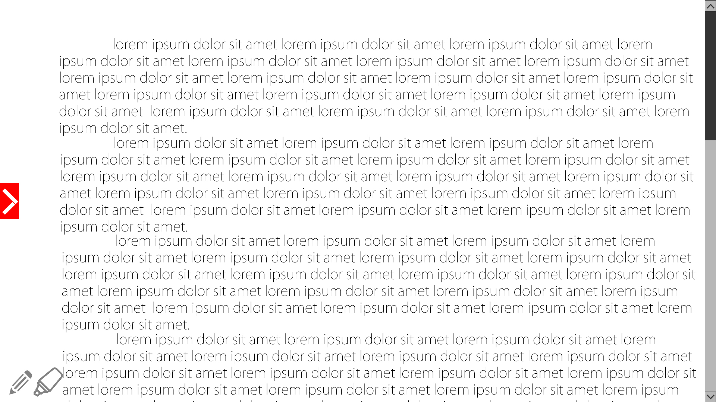
Reading page
Navigation bar used to open menu
Pencil button used to circle around the text
Textliner used to mark the sentence.
Scroll used to move the text up or down

Slide 14
thankyou

